Slide 1
Review 1
1. Software Components
2. Hardware Components
3. cloud installation
4. software requirements specification

Slide 2
Software Components
Unity[Game Engine ]:
Unity is a cross-platform game engine developed by Unity Technologies, first announced and released in June 2005 at Apple Inc.’s Worldwide Developers Conference as a Mac OS X-exclusive game engine. As of 2018, the engine had been extended to support more than 25 platforms.
Texture
3D-Modeling
Scripting
Animation
2. Blender:
Blender is a free and open-source 3D computer graphics software toolset used for creating animated films, visual effects, art, 3D printed models, motion graphics, interactive 3D applications, virtual reality and computer games.
Texture
3D-Modeing
Animation
3. Microsoft Visual Studio:
C# (pronounced ”see sharp”) is a computer programming language. It is developed by Microsoft. It was created to use all capacities of .NET platform.

Slide 3
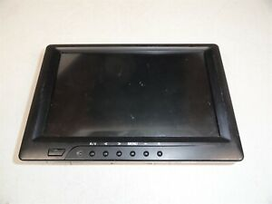
Hardware Components
Mobile
Single screen with camera and OS
Laptop with extremal camera

Slide 4
cloud installation
Vuforia Engine in AR Foundation:
Vuforia Engine can now be used alongside AR Foundation in the same scene regardless of which platform you started developing with. Utilize both platforms to enhance your AR project by simply adding either to your project via Unity’s Package Manager.
Requirements:
Unity 2019.4 and later is supported
Vuforia Engine 9.5 and later.
AR Foundation 4.0 and later.
ARKit and/or ARCore.

Slide 5
software specification
2.5 GHZ Processor
4GB RAM
Graphics Card
500GB store

